Slide 1


Unlocking the Economic Benefits
Of Digital Signage

Slide 2

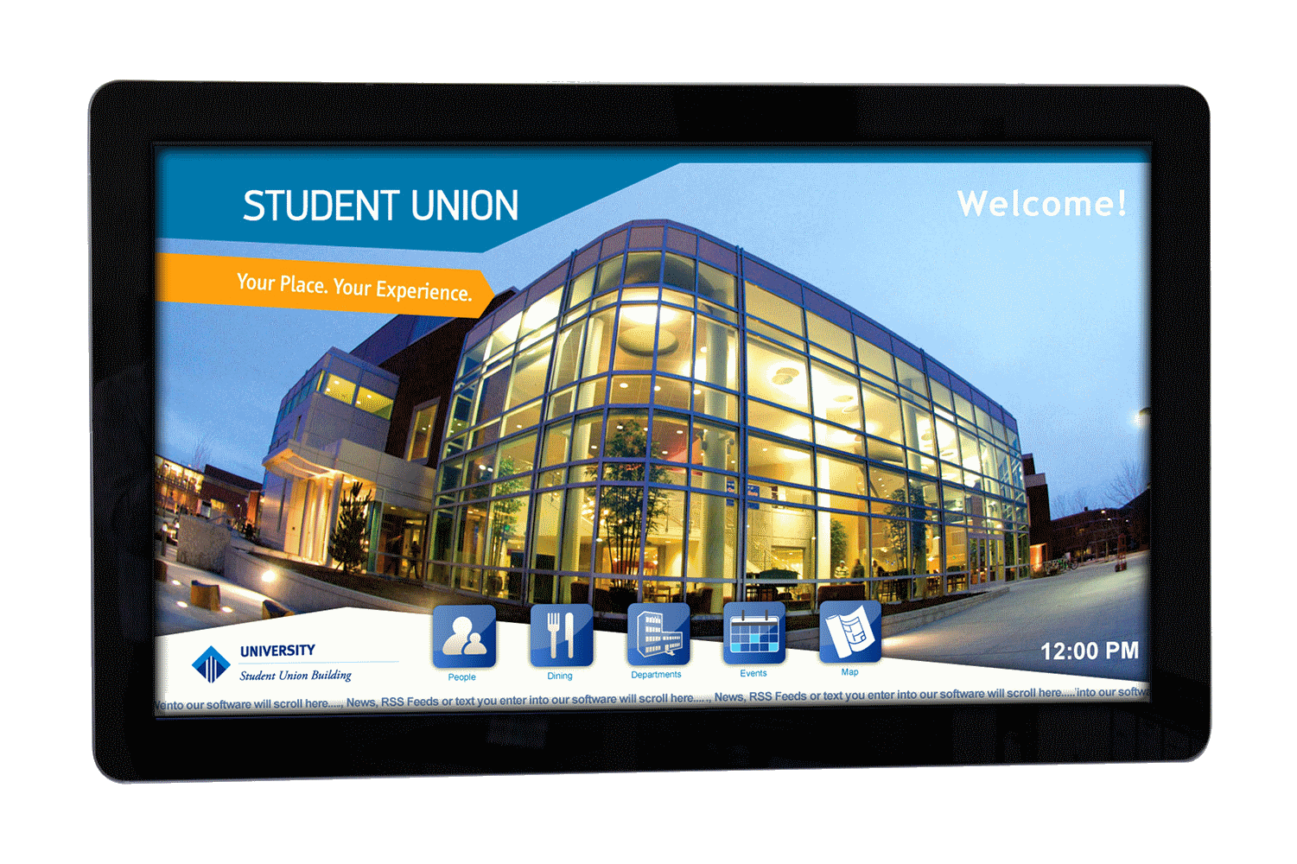
Digital Signage Benefits to the Value Chain
Unlocking Economic Benefits of Digital Signage
Sign Companies
End Customers
Audience

Slide 3
Benefits to…
Sign Companies
Expand Business
Make Money
Position in Digital Future World
Reason to Call Up Customers
No Capital Expense
Be Prepared for Shift
to Digital
Leverage Existing Relationships
No Inventory Expense
Reinforce Print Messaging
Increased Sales & Profit

Slide 4
How Sign Companies Make Money…
$$
Service
No Inventory
No CapEx
Immediate Availability
$$
Installation
$$
Content (Graphic Design)
$$
SurroundsEnclosures Wraps
Scale Benefits
$$
Digital Signage Mark-Up
All Good Margin
Digital Signage Cost

Slide 5
Make Money Selling “Value-Added Digital Signage”
Content /
Graphic Design
Tip #1 - Your End Customer May Do Own In-House Graphics – Still Quote Them
Tip #2 - You May Not Have Trained In-House Graphics, Use a Third Party
Surrounds
Enclosures
Wraps
Tip #3 - Create Brochures or Web-Page with Images of Enclosures, Surrounds,
and Wraps to Drive Increased Revenue.

Slide 6
Make Money Selling “Value-Added Digital Signage”
Installation
Tip #4 - Make Money on Installations with Easy-to-Use Standardized Mounts
Tip #5 - Upside From Additional Infrastructure: Cabling, Etc.
Service & Support
Tip #6 - Quote Customers on Annual Service & Support Agreements
Project Scale
Tip #7 - Take Advantage of the Benefits of Larger Project Scale

Slide 7
Digital Signage Benefits to the Value Chain
Unlocking Economic Benefits of Digital Signage
Sign Companies
End Customers
Audience

Slide 8
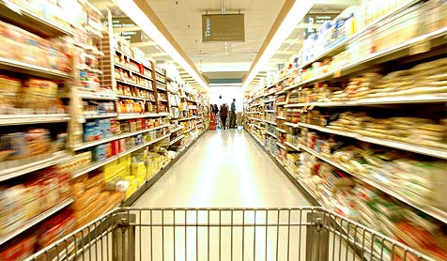







Digital Signage Popular Vertical Markets – End Customers
Retail
Medical
Corporate
Food Service
Hospitality
Banking
Religion
Education

Slide 9
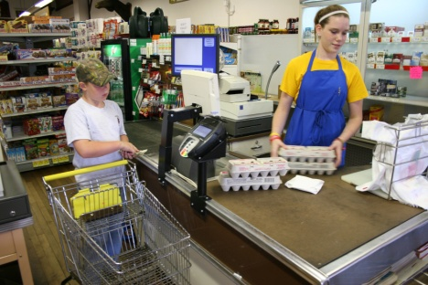
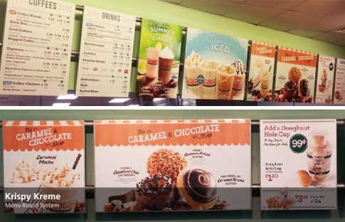
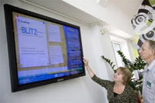
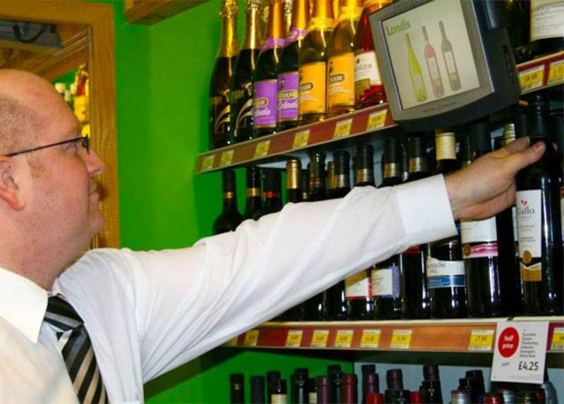

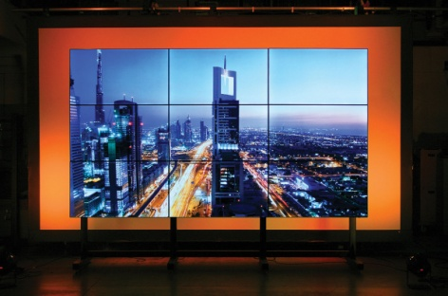
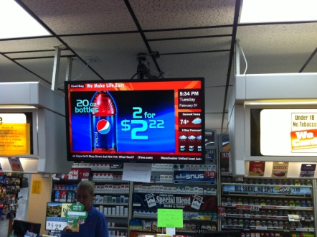
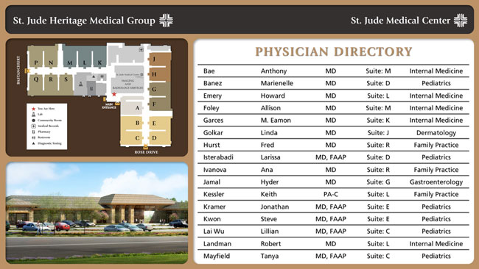
Digital Signage Popular End Customer Applications
Check-out
Menu Boards
Workforce
Communications
Shelf Media
Video Walls
In-store
Promotions
3rd Party
Advertising
Wayfinding/
Directories

Slide 10
Benefits to End Customer
Reduce Costs
Increase Sales
Qualitative

Slide 11
End User Business Benefits
Reduce Cost
Replace Posters
Sales Promotion
Branding
Cost
Reduce Costs of Production, Distribution and Labor
Spread Initial Cost of Digital Signage over 5+ Years
Streamline Communications
Lower Costs
Respond Fast to Changing Markets
Sales
More Frequent Promos based on seasons, demographics, inventory, and price
Continuous Support for Brand via Sign Placement ,Content and Interaction
Targeted Promos
Advertising
Product Demos
Menu Boards
Sales
Drive Sales of Overstocks, up-sell customers with related products
Earn additional revenue by carrying 3rd Party Ads
Use education/demos to drive sales, enhance support and service
More Frequent Price Changes and Promo
Enhanced Customer Experience drives Sales.
Directory / Wayfinding
Customer Support
Employee Communication
Ambience
Simplify Customer Experience
Drive Traffic to Increase Sales
Enhance Service by Providing more ways to learn, engage, and interact.
Use for Internal Updates
Enhance Customer Experience
Entertain while Waiting
Qualitative

Slide 12
Digital Signage Benefits to the Value Chain
Unlocking Economic Benefits of Digital Signage
Sign Companies
End Customers
Audience

Slide 13
Know the Audience Hot Buttons
Retail
Medical
Shopper Experience, Ambiance
Promote Sales / Merchandise Effectively
Bring Online Experience Into the Store
Patient Experience
Medical Advice - Wellness
Ambiance / Entertain While Waiting
Directory / Wayfinding
Education
Banking / Financial
Student Experience
Campus Schedules / Events Info
Directions / Wayfinding
Sports / Curriculum Promotion
Customer Experience, Ambiance
Bring Online Experience Into the Store
Bank Programs
Hospitality
Corporate
Tenant Experience
Menu Boards
Employee Communication
Vendor Welcome
Safety Messages
Enhance Guest Experience
Updates on Meetings, Events, Activities

Slide 14
Educate Your Sales Staff – On Benefits
Unlocking Economic Benefits of Digital Signage
Sign Companies
End Customers
Audience

Slide 15
See You at Booth #203
Unlocking the Economic Benefits
Of Digital Signage

